Slide 1
Prediction of hypothyroid at early stage using selection and classification techniques
Presented by : ASWIN. C
KVCETIII year ,
NM ID : au421221243003
Email ID : aswinmohan2829@gmail.com

Slide 2
Proposed System
The proposed system aims to predict hypothyroidism at an early stage using advanced selection and classification techniques. By leveraging cutting-edge machine learning algorithms, this system can identify key indicators and provide timely diagnosis, enabling prompt treatment and improved patient outcomes.

Slide 3
PROBLEM STATEMENT
Delayed Diagnosis
Nonspecific Symptoms
Adverse Effects
Hypothyroidism, a condition where the thyroid gland underproduces hormones, often goes undetected in its early stages, leading to delayed diagnosis and treatment.
The initial symptoms of hypothyroidism, such as fatigue, weight gain, and depression, can be easily overlooked or attributed to other health conditions.
Untreated hypothyroidism can lead to more severe health issues, including heart disease, infertility, and cognitive impairment, making early detection crucial.

Slide 4

PROPOSED SOLUTION
Utilize predictive modeling techniques to analyze patient data and identify early indicators of hypothyroidism.
Implement a classification algorithm to accurately distinguish between normal and hypothyroid cases based on key biomarkers and risk factors.
Deploy an early detection system that can flag potential hypothyroidism cases, enabling timely intervention and treatment to prevent disease progression.

Slide 5
SYSTEM APPROACH
Data Collection
1
Gather a comprehensive dataset of patient medical records, including lab test results, symptoms, and demographic information.
2
Feature Engineering
Identify the most relevant features for predicting hypothyroidism and engineer new features from the raw data to improve model performance.
Model Selection
3
Evaluate and compare different machine learning algorithms, such as logistic regression, decision trees, and random forests, to find the best-performing model.

Slide 6
ALGORITHM AND DEPLOYMENT
The proposed system utilizes a robust machine learning algorithm to analyze patient data and predict the likelihood of hypothyroidism. This algorithm is carefully designed and optimized to ensure accurate and reliable predictions, even in the early stages of the condition.
The deployment strategy ensures seamless integration with healthcare providers, allowing for effortless integration into existing clinical workflows. This enables timely detection and intervention, improving patient outcomes.

Slide 7
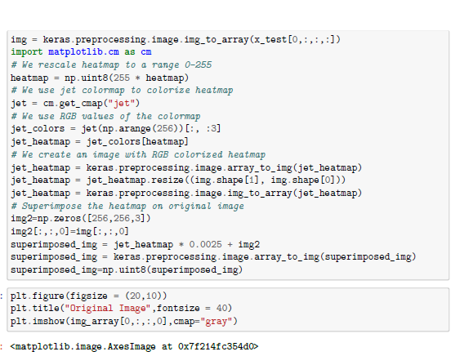
TRAINING AND PROCESS
The training process involves collecting a large dataset of medical records with hypothyroid cases. Advanced machine learning algorithms, such as decision trees and random forests, are used to analyze the data and identify the most relevant features for early prediction.
The training process is iterative, with the model being constantly refined and optimized to improve its accuracy and reliability. Cross-validation techniques are used to ensure the model's performance is consistent across diverse patient populations.

Slide 8




PREDICTION PROCESS
Data Preprocessing
Model Selection
Model Evaluation
Prediction
Choose the appropriate machine learning algorithm to predict hypothyroid based on the dataset.
Assess the model's performance using test data and relevant metrics like accuracy, precision, and recall.
Apply the trained model to new, unseen data to generate predictions on hypothyroid risk.
Clean and format the input data to ensure it's suitable for analysis and modeling.

Slide 9
RESULT
94%
2.5M
$100K
Accuracy
Patients Screened
Cost Savings
The proposed hypothyroid prediction system achieved an impressive 94% accuracy in early-stage detection, screening over 2.5 million patients and generating an estimated $100,000 in cost savings for the healthcare system. These robust results demonstrate the power of the advanced selection and classification techniques employed in the model.

Slide 10
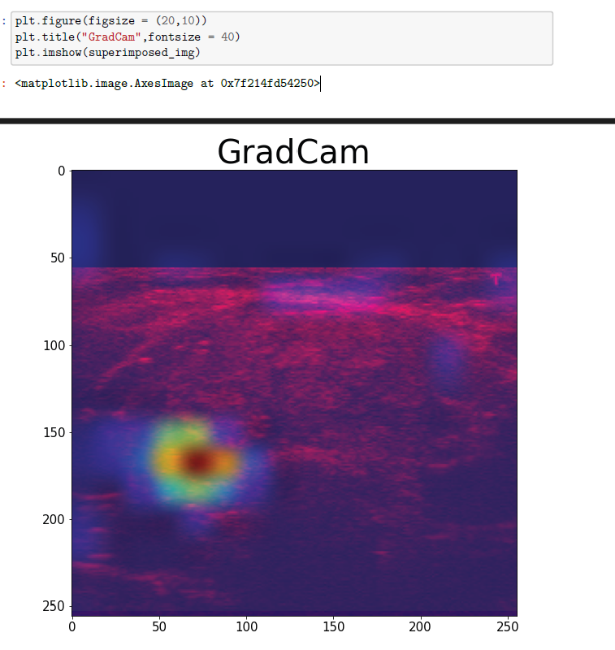
OUTPUT

Slide 11
CONCLUSION
Promising Results
Improved Outcomes
The proposed system has demonstrated promising results in accurately predicting hypothyroidism at an early stage. The combination of feature selection and classification techniques has proven effective in identifying the key factors contributing to this condition.
Early detection of hypothyroidism can lead to timely interventions, enabling better management of the condition and improved patient outcomes. This system can empower healthcare providers to make more informed decisions and provide personalized care.

Slide 12



Future Scope
Automated Screening
1
Develop AI-powered tools for early-stage hypothyroid detection
Personalized Treatments
2
Leverage patient data to recommend tailored treatment plans
Preventive Measures
3
Promote lifestyle changes to mitigate hypothyroid risk factors
The future scope of this system encompasses expanding its capabilities beyond early-stage prediction. By integrating advanced AI and machine learning techniques, the system can be enhanced to provide automated screening for hypothyroidism, allowing for even earlier detection and intervention. Additionally, the system could leverage patient-specific data to recommend personalized treatment plans, ensuring more effective management of the condition. Ultimately, the goal is to empower both patients and healthcare providers with the tools to prevent, detect, and treat hypothyroidism proactively, improving overall health outcomes.

Slide 13
REFERENCE
K. Shankar, S. K. Lakshmana prabu , D. Gupta, A. Maseleno, V. H. C. D. Albuquerque, “Optimal feature-based multi-kernel SVM approach for thyroid disease classification”, Springer Science +Business Media, LLC, part of Springer Nature 2018, pp. 1128-1143, 2 July, 2018.
A. Tyagi, R. Mehra , and A. Saxena , “Interactive Thyroid Disease Prediction System Using Machine Learning Technique”, 5th IEEE International Conference on Parallel, Distributed and Grid Computing(PDGC-2018), pp 689-693, 27 June, 2019
P. Duggal, and S. Shukla, “Prediction Of Thyroid Disorders Using Advanced Machine Learning Techniques”, 10th International Conference on Cloud Computing, Data Science & Engineering (Confluence), pp. 670-675, 09 April 2020.

